Slide 1

Comprehensive PHP Workshop: Building Websites and Web Applications
PHP Unleashed: Quick Hands-On for Smart Coding!

Slide 2

Project analysis slide 6
quick
chat with
audience

Slide 3
Project analysis slide 6
Objective
My Insights and Considerations
Understanding the fundamentals of PHP for web development
Emphasizing best practices in coding standards
Ensuring participants can create simple forms and establish database connectivity

Slide 4
Project analysis slide 6
Agenda
Session-1: Assessing Audience Requirements
Quick chat with Students
Building a Simple HTML Website

Slide 5

Project analysis slide 6
Session-1
Let’s begin with simple HTML web pages
Create following html pages:
home.html
about.html
product.html
services.html
contact_us.html

Slide 6
Project analysis slide 6
Session-1
Let’s begin with simple HTML web pages
Create following html pages:
home.html
about.html
product.html
services.html
contact_us.html
Requirements
Create navigation with each page by creating hyperlink between all the pages.
Display simple message in all the pages.

Slide 7
Project analysis slide 6
Session-1
Let’s begin with simple HTML web pages
Home page
Home
About Us
Products
Services
Contact Us
Home Page…….

Slide 8
Project analysis slide 6
Session-1
Let’s begin with simple HTML web pages
About us page
Home
About Us
Products
Services
Contact Us
About Us Page…….

Slide 9

How much time is required to develop simple web pages?
Home page
Home
About Us
Products
Services
Contact Us
Home Page…….

Slide 10
How much time is required to develop simple web pages?
Home page
Home
About Us
Products
Services
Contact Us
Approx
10 mins ?
Home Page…….

Slide 11

Project analysis slide 6
Session-1
Let’s begin with simple HTML web pages
New Requirement:
- Add news.html page in website, make proper navigation between all the pages.
Home
About Us
Products
Services
Contact Us
News
News Page…….

Slide 12
Project analysis slide 6
Agenda
Session-2: Getting start with PHP
PHP Coding Standards
Building a Simple HTML Website using PHP

Slide 13
Project analysis slide 8
PHP Coding Standards
Naming Conventions
Use meaningful and descriptive names for variables, functions, and classes
PHP conventions often prefer snake_case for variable and function names and PascalCase for class names
Bad Naming
$a = “John”; //Ambiguous variable
function foo($x, $y){
return $x + $y;
}
class abc{
public $name;
public $email;
}

Slide 14
Project analysis slide 8
PHP Coding Standards
Naming Conventions
Use meaningful and descriptive names for variables, functions, and classes
PHP conventions often prefer snake_case for variable and function names and PascalCase for class names
Bad Naming
Good Naming
$a = “John”; //Ambiguous variable
function foo($x, $y){
return $x + $y;
}
class abc{
public $name;
public $email;
}
$customer_name = “John”; //Descriptive variable

Slide 15
Project analysis slide 8
PHP Coding Standards
Naming Conventions
Use meaningful and descriptive names for variables, functions, and classes
PHP conventions often prefer snake_case for variable and function names and PascalCase for class names
Bad Naming
Good Naming
$a = “John”; //Ambiguous variable
function foo($x, $y){
return $x + $y;
}
class abc{
public $name;
public $email;
}
$customer_name = “John”; //Descriptive variable
function sum_of_two_num($num1, $num2){
return $num1 + $num2;
}

Slide 16
Project analysis slide 8
PHP Coding Standards
Naming Conventions
Use meaningful and descriptive names for variables, functions, and classes
PHP conventions often prefer snake_case for variable and function names and PascalCase for class names
Bad Naming
Good Naming
$a = “John”; //Ambiguous variable
function foo($x, $y){
return $x + $y;
}
class abc{
public $name;
public $email;
}
$customer_name = “John”; //Descriptive variable
function sum_of_two_num($num1, $num2){
return $num1 + $num2;
}
class CustomerDetails{
public $name;
public $email;
}

Slide 17
Project analysis slide 6
Session-2
Unit-1: Big Data, Database
Unit-2: SQL
Overview of Big Data
Data, Information, Database
Introduction to SQL, MySQL
Data retrieval using MySQL

Slide 18
Project analysis slide 6
Syllabus
Unit-1: Big Data, Database
Unit-2: SQL
Unit-3: R Programming
Overview of Big Data
Data, Information, Database
Introduction to SQL, MySQL
Data retrieval using MySQL
Introduction to R Language
Data Manipulation, Graph, Regression

Slide 19
Project analysis slide 6
Syllabus
Unit-1: Big Data, Database
Unit-2: SQL
Unit-3: R Programming
Overview of Big Data
Data, Information, Database
Introduction to SQL, MySQL
Data retrieval using MySQL
Introduction to R Language
Data Manipulation, Graph, Regression
Unit-4, 5: Python
Introduction to Python Programming Concept
Data Manipulation, Time Series & Text Analytics using Python

Slide 20
Examination
Internal assessment
50 Marks Question Paper
Practical Exam
Write SQL/R/Python code

Slide 21
Examination
Internal assessment
Semester end assessment
50 Marks Question Paper
Practical Exam
Write SQL/R/Python code
50 Marks MCQ paper
50 questions with multiple choice option
1.5 hrs

Slide 22
Class timings
Weekly once (on Saturday)
09:00AM – 10:10AM
Theory Sessions
~3 hrs
10:10AM – 10:30AM
Break
10:30AM – 12:00PM
Practical Sessions

Slide 23
Class timings
Weekly once (on Saturday)
09:00AM – 10:10AM
Theory Sessions
~3 hrs
Theory Sessions
01:00PM – 02:10PM
10:10AM – 10:30AM
Break
Break
02:10PM – 02:30PM
10:30AM – 12:00PM
Practical Sessions
Practical Session
02:30PM – 04:00PM

Slide 24
Software Tools for BDTM
XAMPP
R
R Studio
Python
Unit 2
Unit 3
Unit 4 & 5

Slide 25
Project analysis slide 8
What is a Data ?
Data is a collection of information gathered by observations, measurements, research or analysis
It consists of facts, numbers, names, figures or even description of things.
Data can be organized in the form of free text, images, graphs, tables
Example :
City | Min. Temp. (in Degrees) | Max. Temp. (in Degrees) | Rain
Mumbai | 25 | 40 | 22%
Delhi | 32 | 45 | 16%
Bangalore | 23 | 35 | 28%
Chennai | 33 | 48 | 21

Slide 26
Project analysis slide 8
What is a Digital Data ?
Digital data is data that represents other forms of data using specific machine language systems that can be interpreted by various technologies.
The most fundamental of these systems is a binary system, which simply stores complex audio, video or text information in a series of binary characters, traditionally ones and zeros, or "on" and "off" values.

Slide 27
Project analysis slide 8
Data Sources
Internal data sources
Information that comes directly from the company’s systems and are specific to the company in question
Example:
Sales, Cash Flow, Production
Customer Relationship Management(CRM)
Enterprise Resource Planning(ERP) system
OLTP and operation data

Slide 28
Project analysis slide 8
Data Sources
Internal data sources
External data sources
Information that comes directly from the company’s systems and are specific to the company in question
Example:
Sales, Cash Flow, Production
Customer Relationship Management(CRM)
Enterprise Resource Planning(ERP) system
OLTP and operation data
Information that comes from outside of company’s or provided 3rd party vendor.
Example:
Internet, Social Media data
Government
Market Research Organization
Business Partners**

Slide 29
Project analysis slide 8
Types of Digital Data
Types of
Digital data

Slide 30
Structured data
Types of
Digital data

Slide 31
Structured data
Types of
Digital data
Semi-structured data

Slide 32
Structured data
Types of
Digital data
Unstructured data
Semi-structured data

Slide 33
Structured data
+
~20%
Types of
Digital data
Unstructured data
Semi-structured data

Slide 34
Structured data
+
~80%
~20%
Types of
Digital data
Unstructured data
Semi-structured data

Slide 35
Project analysis slide 8
Structured Data
Structured data can be defined as the data that has a defined repeating pattern.
This pattern makes it easier for any program to sort, read, and process the data.
Processing structured data is much easier and faster than processing data without any specific repeating patterns.

Slide 36
Project analysis slide 8
Structured Data
Structured data can be defined as the data that has a defined repeating pattern.
This pattern makes it easier for any program to sort, read, and process the data.
Processing structured data is much easier and faster than processing data without any specific repeating patterns.
Example:
Customer ID | Customer Name | Product ID | City | State
12345 | Smith | 214 | Mumbai | Maharashtra
23456 | John | 365 | Bangalore | Karnataka
34567 | Nick | 222 | Pune | Maharashtra
45678 | Sagar | 456 | Chennai | Tamil Nadu

Slide 37
Project analysis slide 8
Semi-Structured Data
Semi-structured data, also known as having a schema-less or self describing structure, refers to a form of structured data that contains tags or markup elements in order to separate out the elements and generate hierarchies of records and fields in the given data.

Slide 38
Project analysis slide 8
Semi-Structured Data
Semi-structured data, also known as having a schema-less or self describing structure, refers to a form of structured data that contains tags or markup elements in order to separate out the elements and generate hierarchies of records and fields in the given data.
Example:
#No | Name | Email
1 | Sam Jocabs | smj@xyz.com
2 | First Name : David Last Name : Brown | davidb@xyz.com
3 | Nick Sagar | Email-1: nick.sager@xyz.com Email-2: nicksager@gmail.com
4 | First Name : John Middle Name : P Last Name : Todd | Personal Email: johntodd@gmail.com Business Email: john@xycompany.com

Slide 39
Project analysis slide 8
Unstructured Data
Unstructured data is a set of data that might or might not have any logical or repeating patterns. About 80% of enterprise data consist of unstructured content.
What are the unstructured data ?

Slide 40
Project analysis slide 8
Unstructured Data
Unstructured data is a set of data that might or might not have any logical or repeating patterns. About 80% of enterprise data consist of unstructured content.
What are the unstructured data ?
Videos
Audio/Music
Emails
Social media
Maps

Slide 41
What if it gets combine?
Structured data
Semi-Structured data
Unstructured data

Slide 42
What if it gets combine?
Structured data
Big Data
Semi-Structured data
Unstructured data

Slide 43
What is a Big Data?
Big data refers to the datasets that are too large or complex to be manage by traditional data-processing software.
Big data is structured, semi-structured and unstructured or heterogeneous in nature. It becomes difficult for computing system to manage “Big Data” because of the extreme speed and volume at which it is generated

Slide 44
Characteristics of Big Data
Big Data
Challenge with existing system
Classified into 4Vs
Complex data ?
Is a new data challenge
that requires leveraging
existing system differently
Volume
Velocity
Variety
Veracity
Is usually unstructured
and qualitative in nature

Slide 45

BIG DATA
Tweets
Every second ~6000 tweets

Slide 46


BIG DATA
Tweets
Facebook
Every second ~6000 tweets
Every minute
~5 lacs comments,
~3 lacs status update,
~1.5 lacs photos upload

Slide 47

BIG DATA
Tweets
Facebook
Every second ~6000 tweets
Every minute
~5 lacs comments,
~3 lacs status update,
~1.5 lacs photos upload
UPI
Every day around
~6.5 billion transactions

Slide 48


BIG DATA
Tweets
Facebook
Every second ~6000 tweets
Every minute
~5 lacs comments,
~3 lacs status update,
~1.5 lacs photos upload
UPI
Every day around
~6.5 billion transactions
E-Commerce
Every day approximate 1.6 million shipment

Slide 49
Big Data - 4Vs
According to Gartner, data is growing at the rate of 59% every year. This growth can be depicted in terms of the following four Vs.
Volume
Volume is the amount of data generated by organizations or individuals.

Slide 50
Big Data - 4Vs
According to Gartner, data is growing at the rate of 59% every year. This growth can be depicted in terms of the following four Vs.
Volume
Volume is the amount of data generated by organizations or individuals.
Velocity
Velocity describes the rate at which data is generated, captured, and shared

Slide 51
Big Data - 4Vs
According to Gartner, data is growing at the rate of 59% every year. This growth can be depicted in terms of the following four Vs.
Volume
Variety
Volume is the amount of data generated by organizations or individuals.
Variety describe the different formats for data such as images, text, video, audio, GPS.
Velocity
Velocity describes the rate at which data is generated, captured, and shared

Slide 52
Big Data - 4Vs
According to Gartner, data is growing at the rate of 59% every year. This growth can be depicted in terms of the following four Vs.
Volume
Variety
Volume is the amount of data generated by organizations or individuals.
Variety describe the different formats for data such as images, text, video, audio, GPS.
Velocity
Velocity describes the rate at which data is generated, captured, and shared
Veracity
Veracity generally refers to the uncertainty of data. Whether the obtained data is correct or consistent.

Slide 53
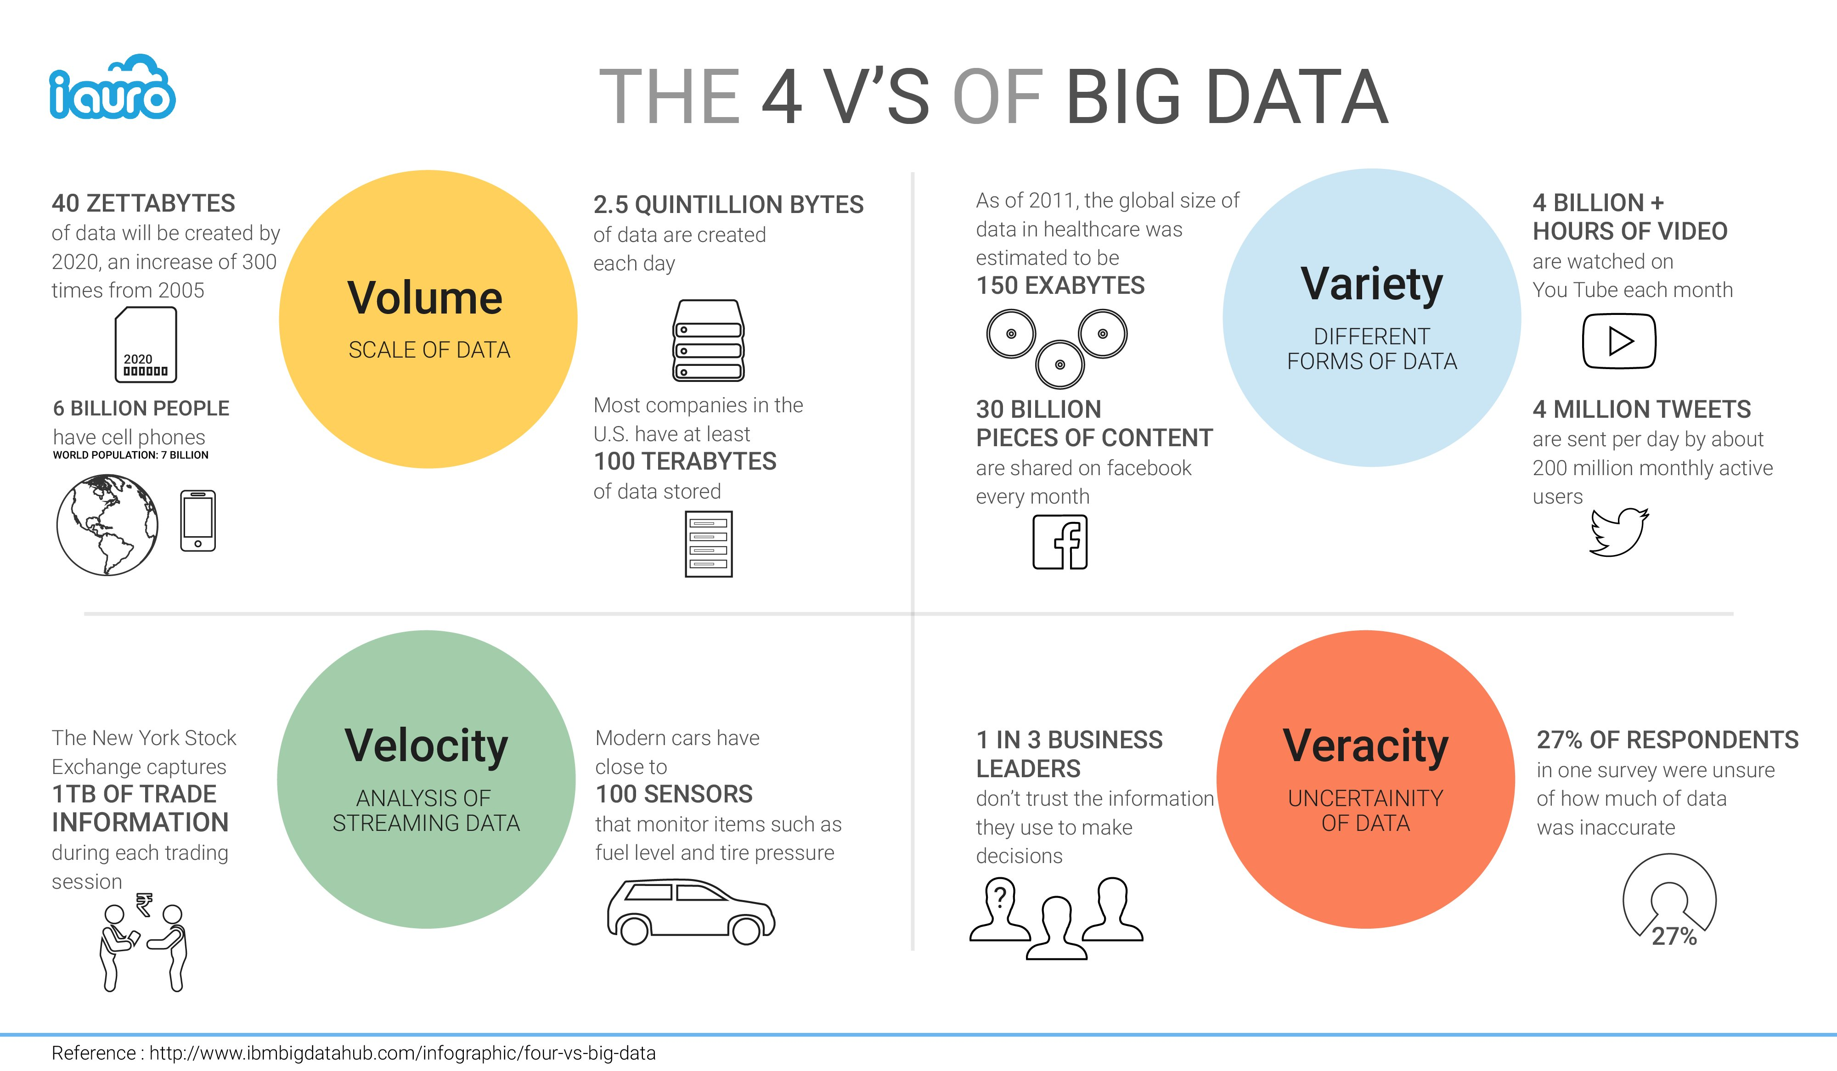

Slide 54
Future of Big Data
Most organizations today consider data and information to be their most valuable assets, that big data can unlock significant value by making information transparent.
Sophisticated analytics can improve decision-making, minimize risks, and actionable insights that would otherwise remain hidden.
At the same time, the volume and variety of data is also increasing at the immense rate every day, so big data can be used to develop the next generation of products and services.

Slide 55
Thank You

